Slide 1
Modeling and Validating the kinematic and dynamic properties of Shape memory alloy based Continuum robots (Temp Title)
Introduction to SMA robots
Name: Vignesh Venkatachalam
Matriculation No.: 21864036
Course: Mechatronics
University: Hamburg University of Technology
Email: vignesh.venkatachalam@tuhh.de

Slide 2
Topics Covered
Motivation
Shape memory alloy
State of the art in SMA robots

Slide 3
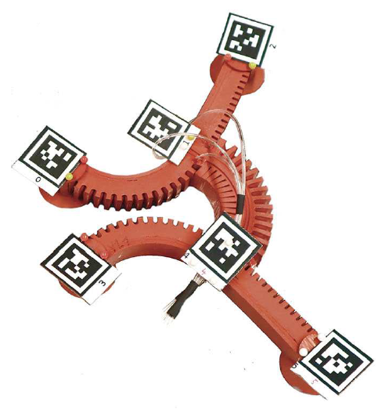
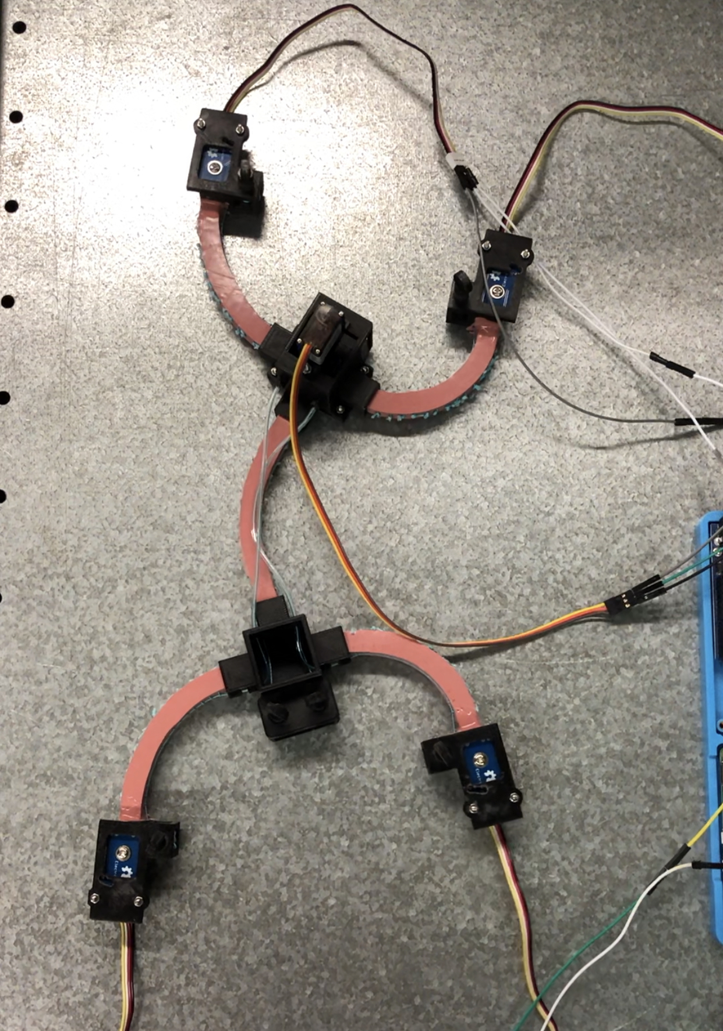
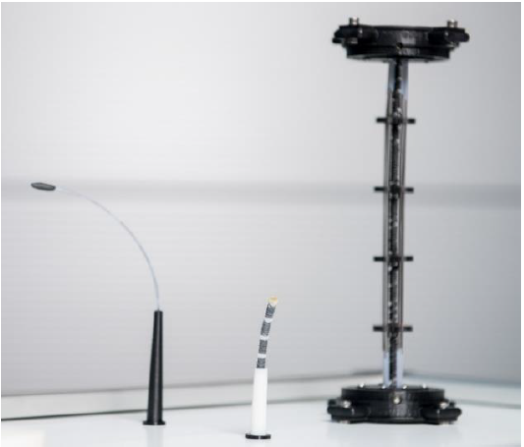
Motivation
Research into Smart materials has brought about innovative actuation methods in Soft robotics
Pneumatic actuators → relatively large pressure valves
Cable-driven actuators → relatively large motors
Smart materials like SMAs integrate well into the robot → only electrical circuit to power them
Modeling necessary to predict their behavior for future control algorithms
Fig. 1: Pneumatically actuated Gecko-inspired robot [1]
Fig. 2: Cable-driven Gecko-inspired robot
Fig. 3: Prototypes of SMA driven continuum robots [2]
Notes:
Common methods currently in use – Pneumatic and Cable-driven

Slide 4
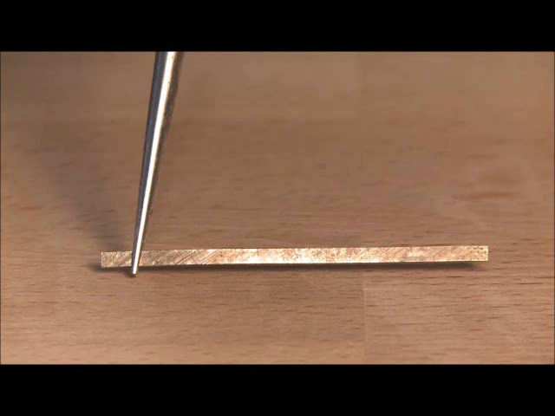
Shape memory alloys – Operating principle
Video courtesy: Intelligent Materials Systems Lab, University of Saarland

Slide 5
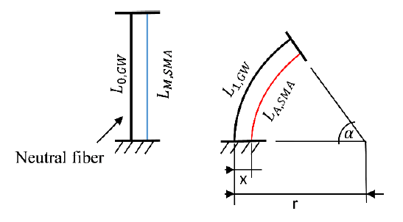
Shape memory alloys - Actuators
SMAs → integrated directly into robot
Actuated by electric current → Joule heating
Heating above austenite transformation temperature leads to a contraction due to phase transformation in lattice crystal material
Initial shape → applying external force (e.g., with another SMA wire)
Non-linear response of strain to input current, hysteresis characteristic
Need accurate mathematical model → more accurate control
Fig. 4: Schematic diagram of a continuum robot with integrated SMA wire for the theoretical design of the actuators. [2]
Notes:
Drawback – non-linear response
Hysteresis leads to imprecise and difficult control
Efficiency of SMA actuator depends on the accuracy of control which in turn depends on the mathematical model

Slide 6
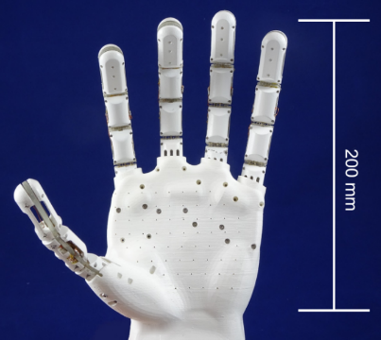

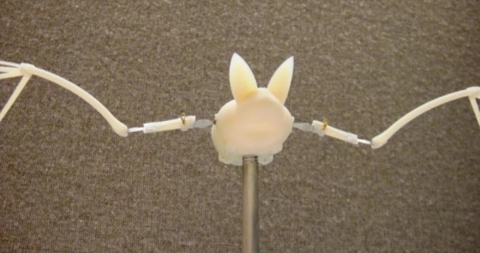
State of the art in SMA robots
Fig. 5: SMA actuated five-fingered soft hand. [3]
Fig. 6: SMA bat. [7]
Video courtesy: Intelligent Materials Systems Lab, University of Saarland

Slide 7
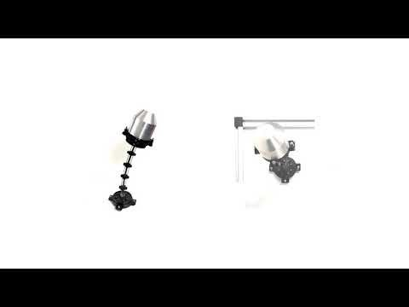
State of the art in SMA robots
Fig. 6: Prototype of SMA wire based continuum robot. [4]
Video courtesy: Intelligent Materials Systems Lab, University of Saarland

Slide 8
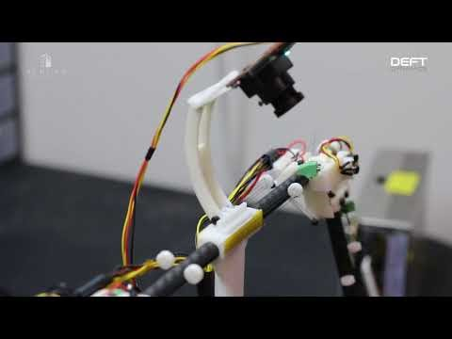
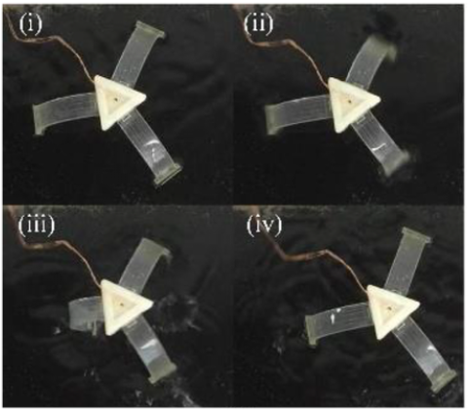
State of the art in SMA robots
Fig. 7: Elongation and contraction test of an SMA based octopus arm. [5]
Fig. 8: Walking robot with soft arms actuated by SMAs. [6]
Video courtesy: Austin Gurley – Auburn University and Deft Dynamics

Slide 9
References
L. Schiller, A. Seibel, and J. Schlattmann, “A lightweight simulation model for soft robot’s locomotion and its application to trajectory optimization,” IEEE Robotics and Automation Letters, 2020. [1]
Y. Goergen, R. Chadda, R. Britz, D. Scholtes, N. Koev, P. Motzki, R. Werthschützky, M. Kupnik, and S. Seelecke, “Shape memory alloys in continuum and soft robotic applications,” in Smart Materials, Adaptive Structures and Intelligent Systems, vol. 59131, p. V001T04A014, American Society of Mechanical Engineers, 2019. [2]
F. Simone, G. Rizzello, S. Seelecke, and P. Motzki. "A soft five-fingered hand actuated by Shape Memory Alloy wires: design, manufacturing, and evaluation." Frontiers in Robotics and AI 7 (2020).

Slide 10
References (Contd.)
Y. Goergen., G. Rizzello, S. Seelecke and P. Motzki (2020, September), “Modular design of an SMA driven continuum robot. In Smart Materials, Adaptive Structures and Intelligent Systems,” (Vol. 84027, p. V001T04A007). American Society of Mechanical Engineers.
T. Zheng, Y. Yang, D. T. Branson, R. Kang, E. Guglielmino, M. Cianchetti, D. G. Caldwell, and G. Yang, “Control design of shape memory alloy based multi-arm continuum robot inspired by octopus,” in IEEE 9th Conference on Industrial Electronics and Applications (ICIEA), pp. 1108–1113, 2014
C. Liu, E. Dong, M. Xu, G. Alici, and J. Yang. "Locomotion analysis and optimization of actinomorphic robots with soft arms actuated by shape memory alloy wires." International Journal of Advanced Robotic Systems 15, no. 4 (2018): 1729881418787943.
S. J. Furst, G. Bunget, and S. Seelecke. "Design and fabrication of a bat-inspired flapping-flight platform using shape memory alloy muscles and joints." Smart Materials and Structures 22, no. 1 (2012): 014011.

Slide 11
Thank you for your attention! Any questions?

